Slide 1
1st Project (Make It Short)
권재욱 21102034
송서하 23102011

Slide 2
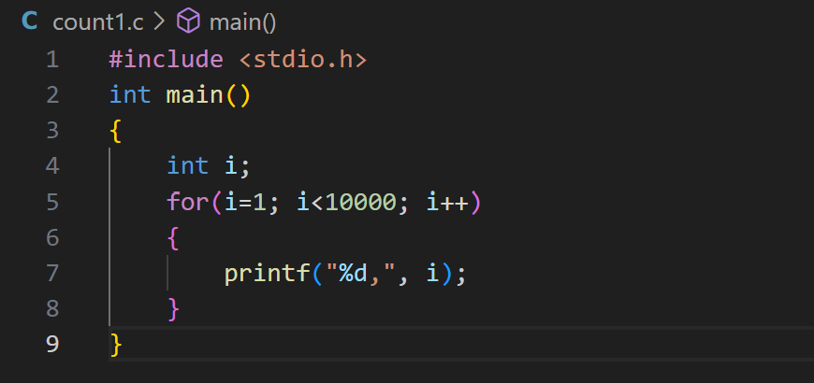
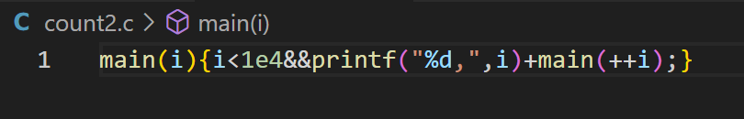
0. Compare before and after
• Original code
• Shortened code
Implicit Function Declaration
recursion, + operator

Slide 3
1. Implicit Function Declaration
In main(i), i is treated as an integer.
Compiler automatically assumes int type.
Shortens the code but not recommended in modern C.

Slide 4
2. Recursive Function Flow
Start: main(1) → printf 1, → main(2)
Repeat: main(2) → printf 2, → main(3)
End: main(10000) stops recursion

Slide 5
Stack Overflow Risk!
Recursion depth increases stack usage.
Without a termination condition, risk of overflow.
Condition i < 1e4 ensures safe exit.

Slide 6
1. Open code
• Original code
-> count1.c
• Shortened code
-> count2.c

Slide 7
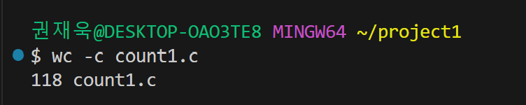
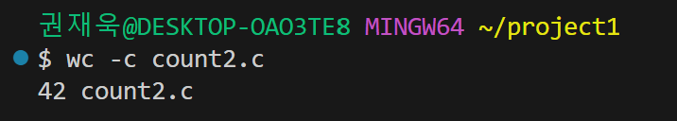
2. Check bytes of each code
Use wc -c filename on Git Bash
• count1.c -> 118 bytes
• count2.c -> 42 bytes

Slide 8

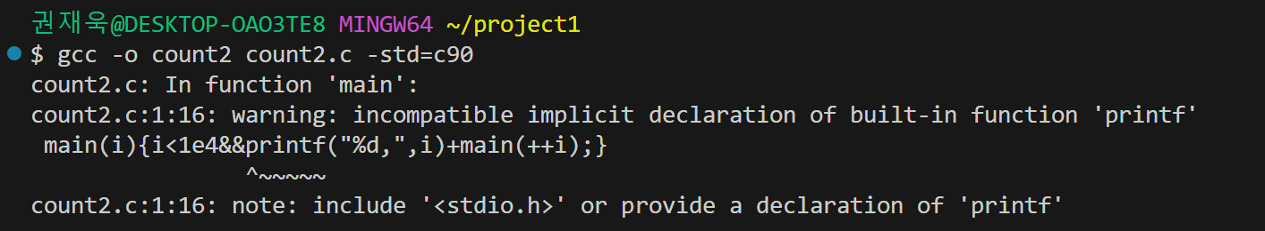
3. Compile codes
Use gcc -o output_filename source_filename.c -std=c90
• compile count1.c
• compile count2.c

Slide 9
Warning!
The warning message occurs because the printf function has not been declared.
Implicit Function Declaration

Slide 10


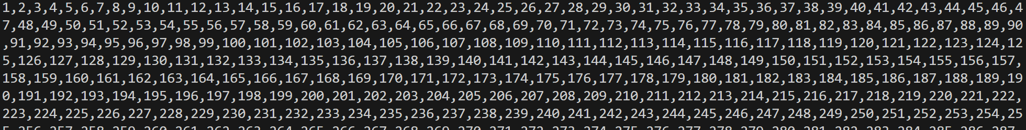
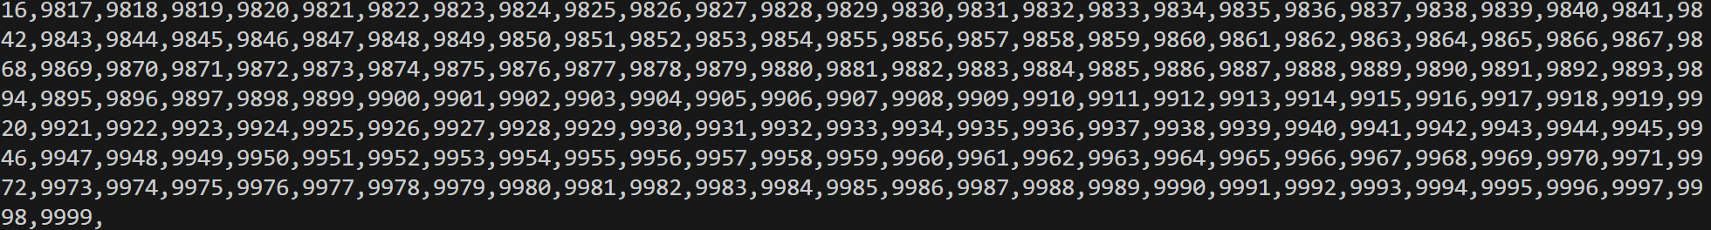
4. Run executable file
./count1
./count2
1 ~ 9999
~

Slide 11
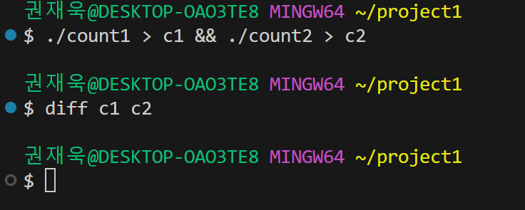
5. Compare results
Use diff file1 file2
If the two files are identical, there will be no output.
If there are differences, diff will display them.

